Slide 1
AIR CONDITIONING · CHAPTER 1
1.6 Types of AC Systems
1
2
Capacity units, system families, and selection logic
1.6
Choose the system type by matching building scale, zoning, cost, and operation.
TR/Btu/h/kW
Split
3
4
VRF
Chilled water
Concept-first slides with teaching detail in the card
Air Conditioning · Chapter 1 · Topic 1.6
1

Slide 2
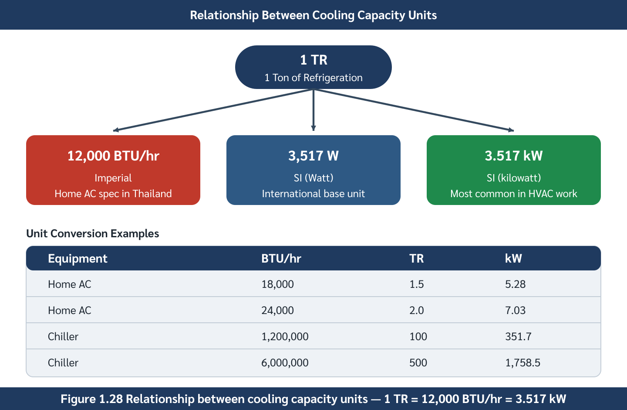
Cooling capacity has three common units
2
Catalogues and standards may not use the same unit system.
CAPACITY UNITS
1 TR = 12,000 Btu/h = 3.517 kW
TR
1
ton of refrigeration
Btu/h
2
common in room AC catalogues
kW
3
SI engineering calculation unit
Cooling capacity unit relationship
Air Conditioning · Chapter 1 · Topic 1.6
2

Slide 3
Preliminary sizing is only a first-pass check
3
Use rules of thumb to sanity-check, not to finalize equipment
Residential
Office
Restaurant
1
2
3
about 300–400 Btu/h·m²
about 500–600 Btu/h·m²
about 600–800 Btu/h·m²
Department store
Caution
4
5
about 700–900 Btu/h·m²
final design still needs load calculation
Air Conditioning · Chapter 1 · Topic 1.6
3

Slide 4
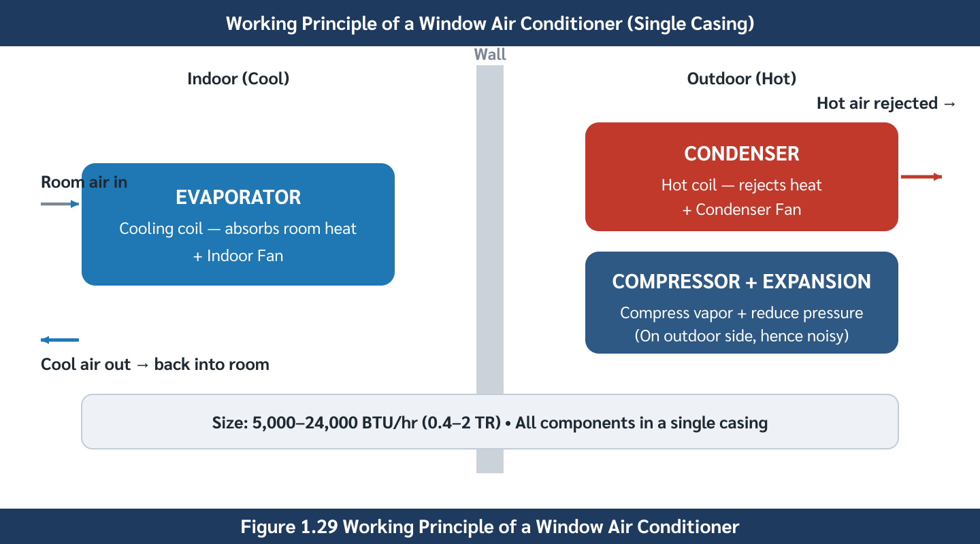
Window units are self-contained and low cost
4
All refrigeration components are inside one cabinet.
SYSTEM TYPE
Simple installation, limited comfort quality
Capacity
1
5,000–24,000 Btu/h
Strength
2
lowest installed cost
Weakness
3
noise, wall opening, lower efficiency
Window air conditioner arrangement
Air Conditioning · Chapter 1 · Topic 1.6
4

Slide 5
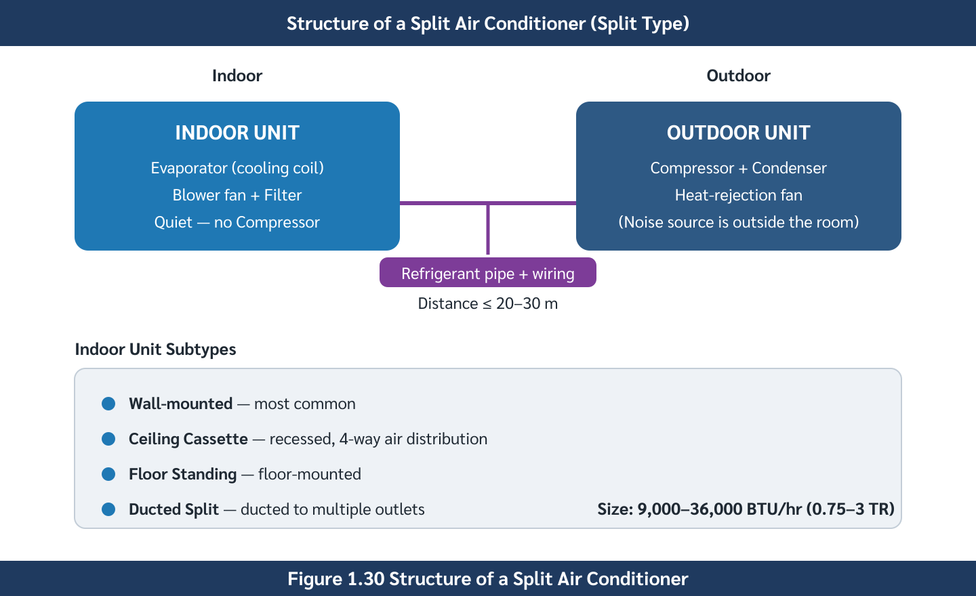
Split systems move the noisy compressor outdoors
5
Indoor comfort improves because the compressor is outside.
SYSTEM TYPE
Most common small-building solution
Indoor unit
1
evaporator coil and indoor fan
Outdoor unit
2
compressor and condenser
Application
3
homes, condos, small offices
Split air conditioner configuration
Air Conditioning · Chapter 1 · Topic 1.6
5

Slide 6
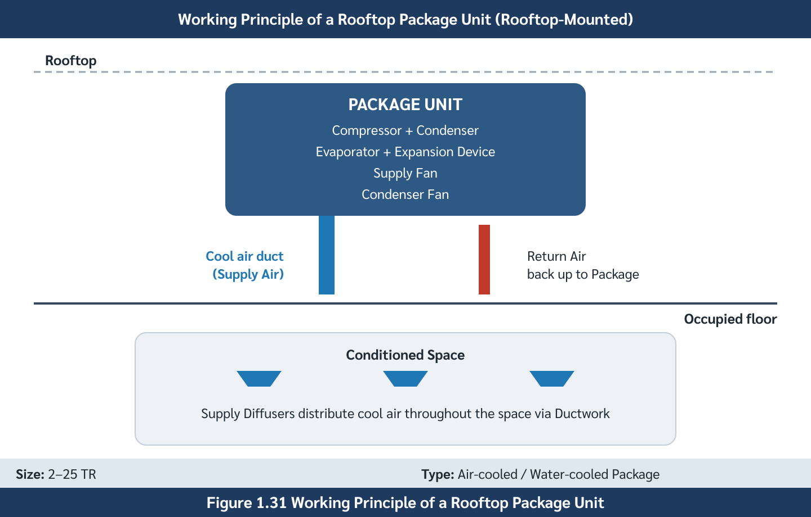
Package units condition one large airflow
6
A rooftop/package cabinet feeds ductwork to a zone.
SYSTEM TYPE
Good for large open spaces
Capacity
1
about 2–25 TR
Strength
2
single mechanical location
Weakness
3
duct loss, roof load, zone-control complexity
Package unit with duct distribution
Air Conditioning · Chapter 1 · Topic 1.6
6

Slide 7
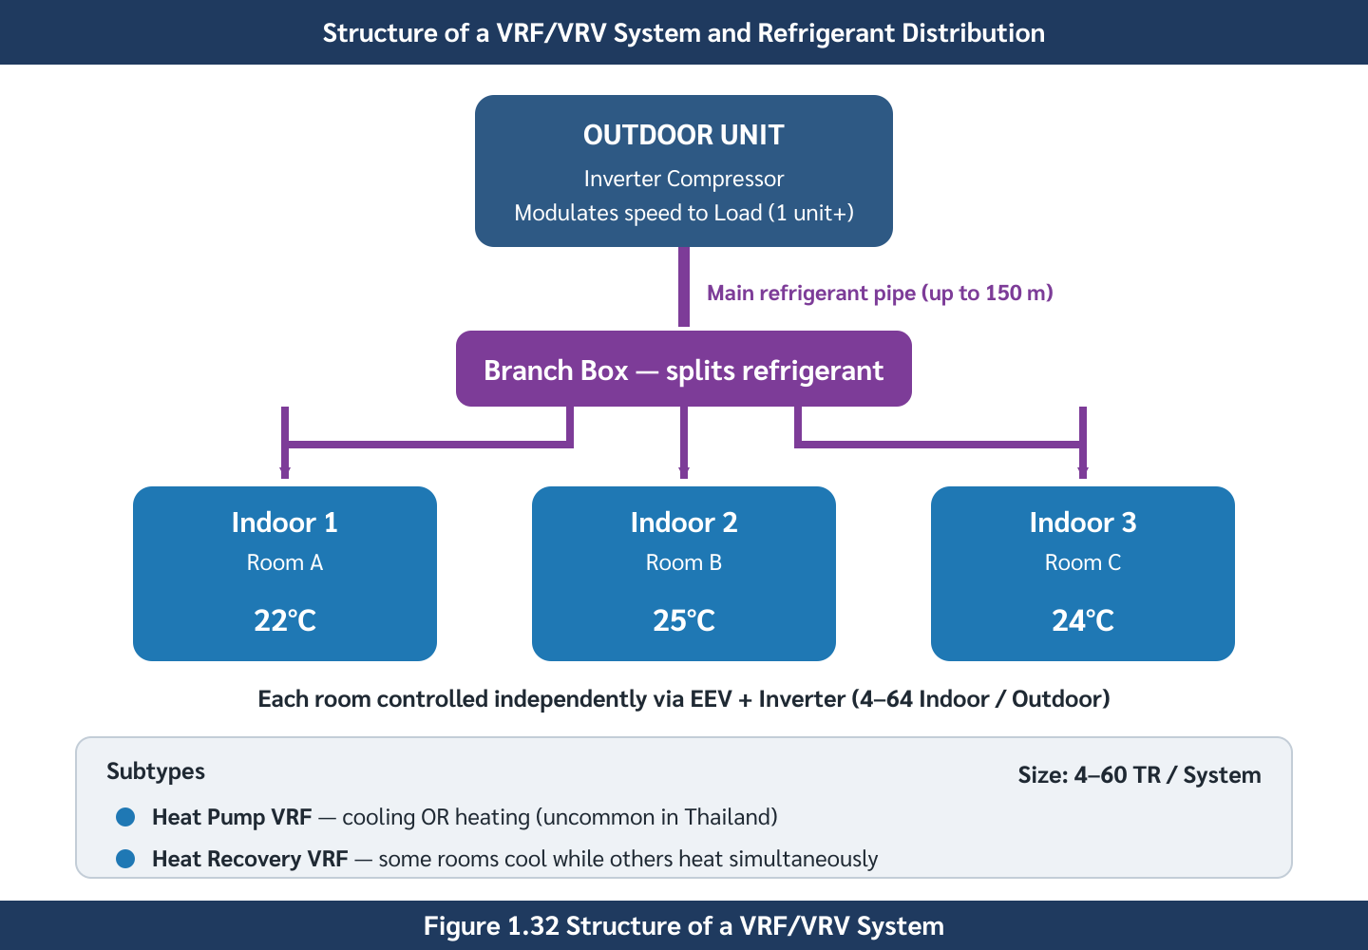
VRF systems give many rooms independent control
7
One outdoor system meters refrigerant to many indoor units.
SYSTEM TYPE
Zoning without a full chiller plant
Independent IDUs
1
each room can control setpoint
Inverter compressor
2
capacity follows load
Watchout
3
cost, leak testing, specialist service
VRF/VRV system configuration
Air Conditioning · Chapter 1 · Topic 1.6
7

Slide 8
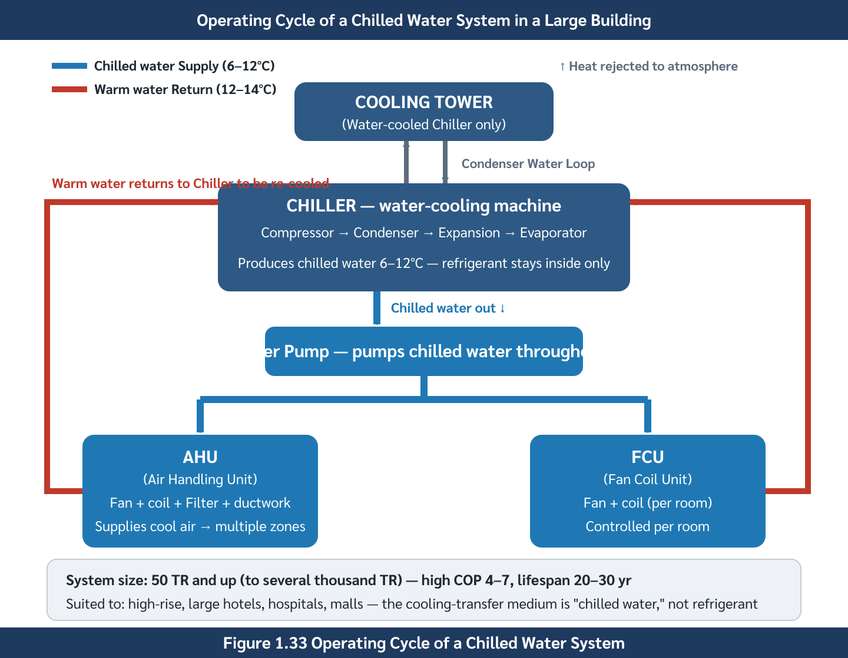
Chilled water systems serve large buildings
8
Refrigerant stays in the chiller; water distributes cooling.
SYSTEM TYPE
Best where scale justifies plant complexity
High efficiency
1
especially water-cooled chillers
Scalable
2
multiple chillers, AHUs, FCUs
Watchout
3
plant room, pumps, tower, skilled operation
Chilled water system circuit
Air Conditioning · Chapter 1 · Topic 1.6
8

Slide 9
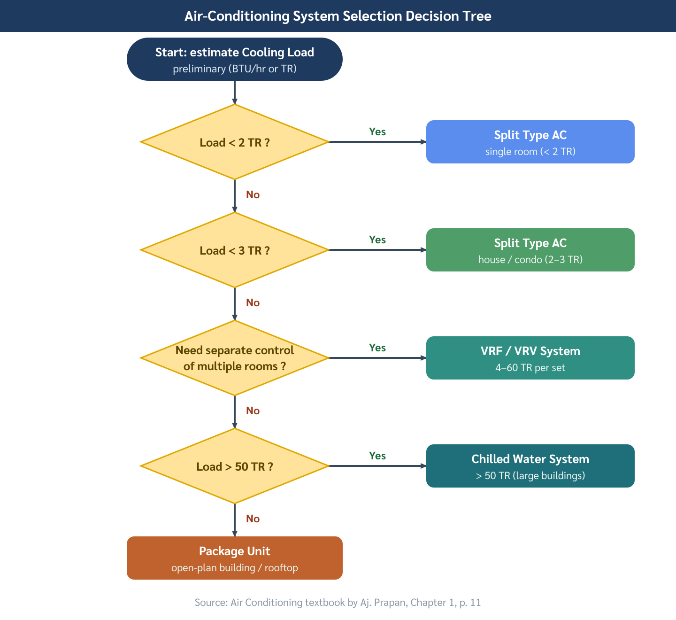
System selection is a trade-off, not a lookup table
9
The correct answer depends on constraints and lifecycle goals.
SELECTION LOGIC
Compare constraints before choosing equipment
Load and scale
1
required TR and operating hours
Zoning
2
one zone or many rooms?
Cost
3
first cost versus energy cost
Comparative overview of system types
Air Conditioning · Chapter 1 · Topic 1.6
9

Slide 10
Worked selection scenarios
10
Ask students to justify each recommendation
Small bedroom
Temporary site office
Retail hall
1
2
3
split AC: quiet and flexible
window or small split: low first cost
package unit or AHU: large open zone
Boutique hotel
Hospital/mall
4
5
VRF or FCU: room-by-room control
chilled water: efficiency and redundancy
Air Conditioning · Chapter 1 · Topic 1.6
10

Slide 11
Pause question: 20-story mixed-use tower
11
Real buildings often need hybrid answers.
DISCUSSION
Retail + office + hotel rarely use one simple system
Retail floors
Load
Zones
Budget
Service
1
central air distribution for open zones
Office floors
System choice = constraints + life-cycle judgement
2
AHU/VAV or chilled water terminals
Hotel suites
3
FCU or VRF for room control
Selection flow: constraints before system type
Air Conditioning · Chapter 1 · Topic 1.6
11

Slide 12
Topic 1.6 — what students should remember
12
1
2
3
Convert capacity fluently
System type follows building scale
Selection is multi-criteria
TR, Btu/h, and kW describe the same cooling rate
room units → split/VRF/package → chilled water
zoning, cost, efficiency, service life, and maintenance
Air Conditioning · Chapter 1 · Topic 1.6
12

